Slide 1

Housing Price Prediction
-Yash Bhardwaj

Slide 2
Outline
Introduction
EDA steps and Visualization
Building Models
Best Model
Conclusion

Slide 3
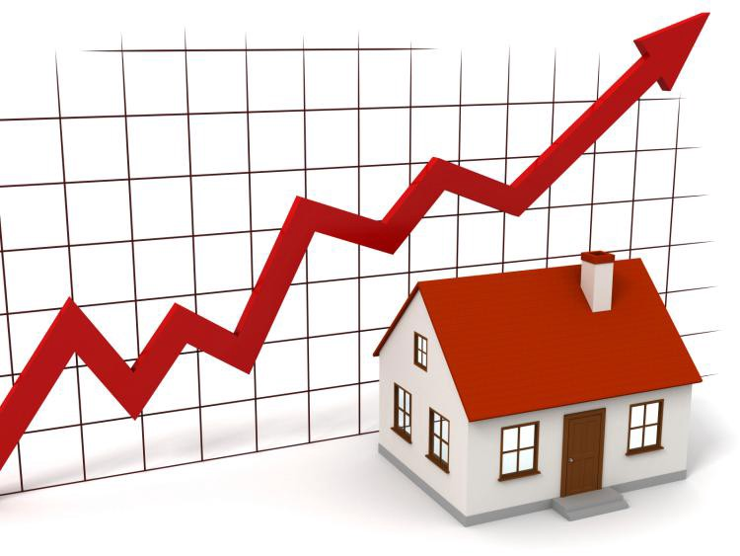
Introduction
Houses are one of the necessary need of each and every person around the globe and therefore housing and real estate market is one of the markets which is one of the major contributors in the world’s economy. It is a very large market and there are various companies working in the domain.
A US-based housing company named Surprise Housing has decided to enter the Australian market. The company uses data analytics to purchase houses at a price below their actual values and flip them at a higher price. For the same purpose, the company has collected a data set from the sale of houses in Australia.
Problem Statement: We need to build a machine learning model predicting the Sale Price of the houses based on several features.

Slide 4
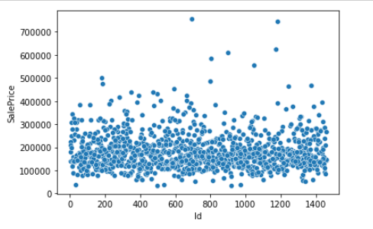
EDA steps and Visualization
So, for building machine learning models certain processes need to be done. The first one is to import the datasets and do the data analysis or exploration. The datasets are given for both training and testing purpose. The training dataset has 81 variables including response variable with 1168 examples.
After that comes EDA i.e. exploratory data analysis and data visualization.
So first we checked out the response variable:

Slide 5
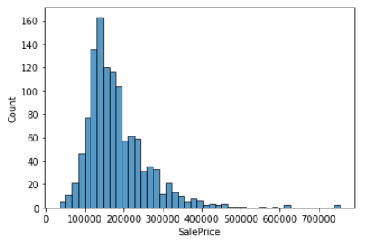
The figure gives us the scatter plot of the sale price. Most of the points are assembled on the bottom.
We can also check out the distribution of response variable for a better understanding.
So, the distribution of sale prices are right skewed, which shows the distribution of the sale prices isn’t normal. It is reasonable because few people can afford very expensive houses.

Slide 6
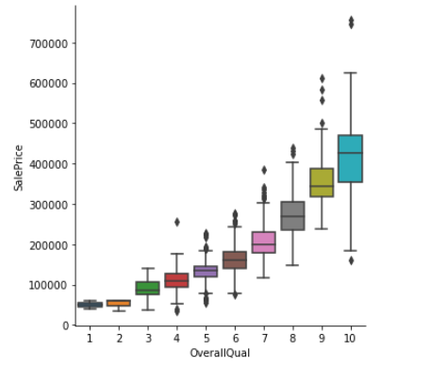
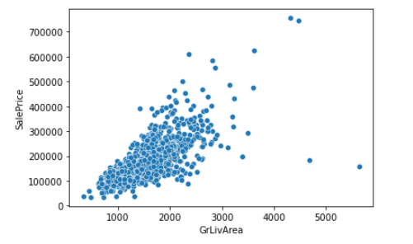
After this we checked out for important features, that are highly correlated with the response variable.
Turns out there are 10 numeric variables with correlations of at least 0.5 with SalePrice. All those correlations are positive. We will visualize the relation between SalePrice and the two predictors with the highest correlation with SalePrice here only. Overall Quality and the Above Grade Living Area.

Slide 7
The above two figure shows the relationship between overall quality with response variable and above grade living area with response variable, respectively.
Overall Quality: We find that there is a positive relationship between the Overall Quality and Sale Price. And it seems like a quadratic relationship or something else like that rather than the linear relationship.
Above grade living area: The correlation between this numeric variable and sale price is 0.71 which the second highest. We can give interpretations to the high correlations. Large above grade (ground) living area means large house, and large house means expensive sale price. This makes sense a lot.
So after doing a little more visualization with other correlated variables, data preprocessing was done.
Firstly all the missing values were find and then replaced by using simple imputer of sci-kit learn.
Once missing values got imputed all the categorical variables were turn into numeric ones so that we can process further with model building algorithms.

Slide 8
Building Models
We had trained several Machine Learning models and compare their results. As the dataset does not provide label variable for their testing-set, we need to use the predictions on the training set to compare the algorithms with each other. Later on, we had used cross validation and other evaluation metrics.
So, we had tried in total 8 different algorithms which include, linear regression, 2 regularization methods, k-neighbors, decision tree and 3 ensemble techniques. While trying out different models we had compare the accuracy score for the best fit model.

Slide 9
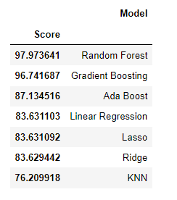
Best Model?
As we can see, the Random Forest regressor goes on the first place. But first, we must check, how random-forest performs, when we use cross validation.

Slide 10
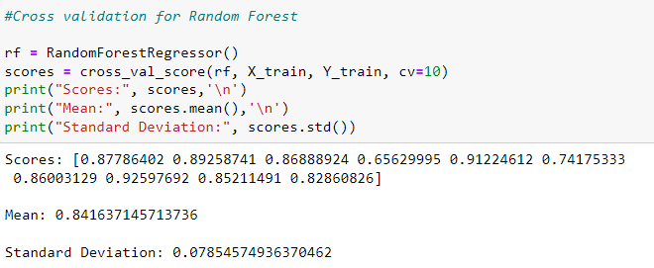
This looks much more realistic than before. Our model has an average accuracy of 84% with a standard deviation of 7 %. The standard deviation shows us, how precise the estimates are. This means in our case that the accuracy of our model can differ + — 7%.
We had performed K-Fold Cross Validation on our random forest model, using 10 folds (K = 10). Therefore it outputs an array with 10 different scores. We then needed to compute the mean and the standard deviation for these scores.

Slide 11
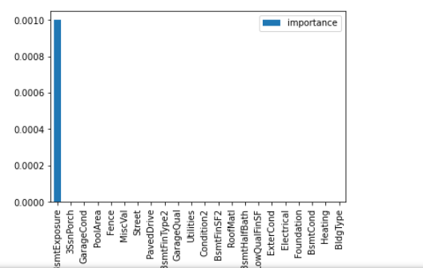
Feature importance:
Another great quality of random forest is that they make it very easy to measure the relative importance of each feature.
It came out to be that 21 feature variables don’t play a significant role in our random forest regressor prediction process. Because of that we dropped them from the dataset and trained the regressor again. We could have also remove more or less features, but this would needed a more detailed investigation of the features effect on our model.

Slide 12
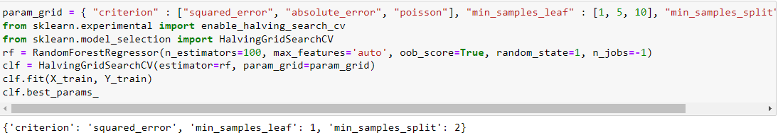
There is also another way to evaluate a random-forest regressor, which is probably much more accurate than the score we used before. What I am talking about is the out-of-bag samples to estimate the generalization accuracy. It is as accurate as using a test set of the same size as the training set. Therefore, using the out-of-bag error estimate removes the need for a set aside test set. The out-of-bag-sample score for the model came out to be around 84%, which is a good score.
So, now that we had selected the model it was time for some hyperparameter tuning for optimized performance. The figure below shows the above only:

Slide 13
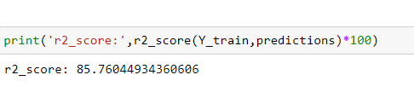
After hyperparameter tuning we passed the optimum value of the parameters through the random forest and trained the model. We then again checked out for out of bag score. This time it came around 86%, which was a good sign.
So now that we had a good model we had do some evaluation metrics for better understanding of the performance of the model. One of the metrics is R-squared score.
Our Random Forest model is giving us a high r-squared score. 85% of R-squared means up to 85% of feature variables movements are completely explained by movements of label variable.

Slide 14
Conclusion
We had gone from analysing the datasets to building several machine learning models.
Then we found out the best fit model, did some analysing including checking feature importance and out of bag score
Afterwards, we did hyperparameter tuning for optimized performance pf the model again checked for out-of-bag score and evaluated our final model with various regression metrics including R-squared score.
Of course there is still room for improvement, like doing a more extensive feature engineering. Another way is to do a more extensive hyperparameter tuning on several machine learning models.

